Slide 1

Sprint 1- Presentation
Team Berlin – Flu Shot Dataset
09-10-2025

Slide 2
Do demographics such as the Age group, Sex etc influence the rate of the flu shot?.
How do behavioral patterns influence the rate of the flu shot?.
Are there distinct groups of individuals (clusters) with similar characteristics in relation to flu shot demographics?
Do personal beliefs and opinions influence the likelihood of receiving H1N1 or seasonal flu vaccines?

Slide 3
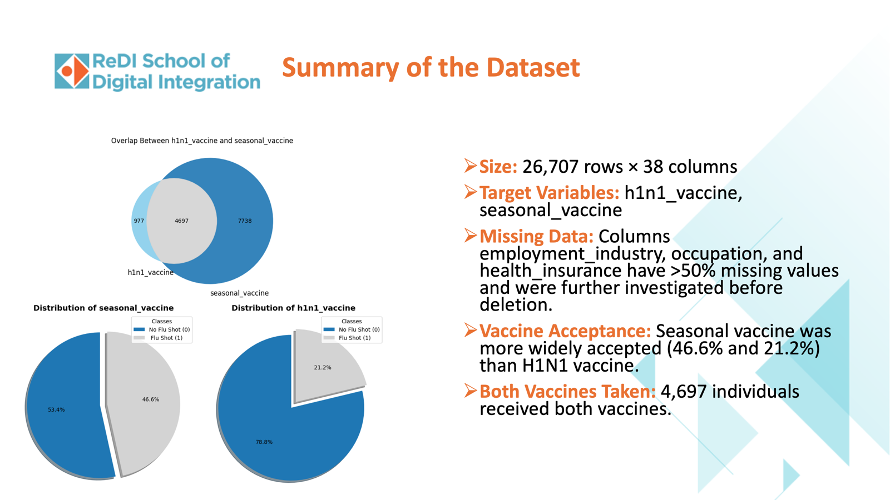

Slide 4
Missing data: Simple Imputer was used to fill in the columns with missing data.
For categorical columns, mode was used to fill in the most occuring data.
For Numerical columns, median was used to fill in the average which makes it resistance to outliers
Categorical data: The dataset, 3 types of categorical data was found
Ordinal Features: Ordinal encoding was used to keep the ranks
Nominal Variable: One hot encoding was used
Binary Variables: This was passed through

Slide 5
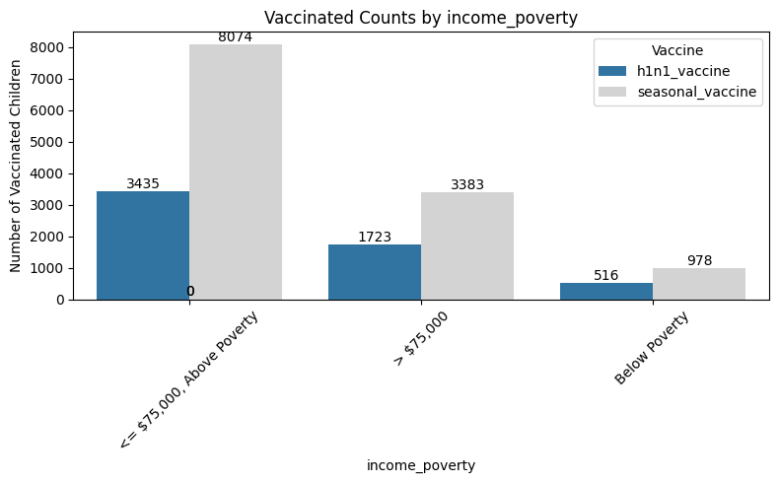
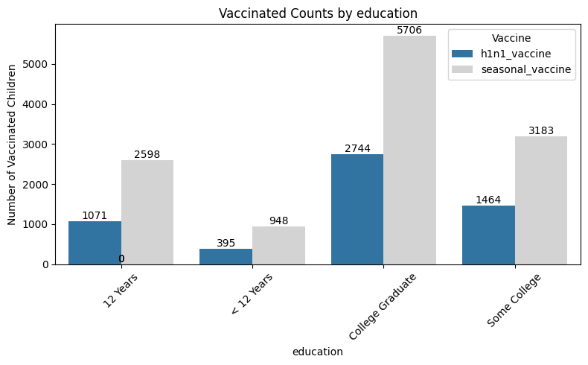
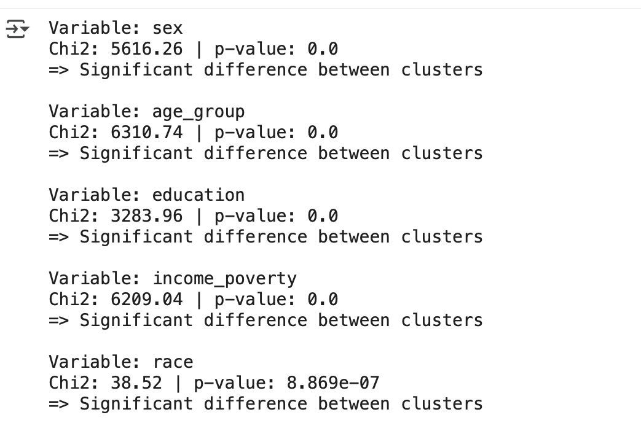
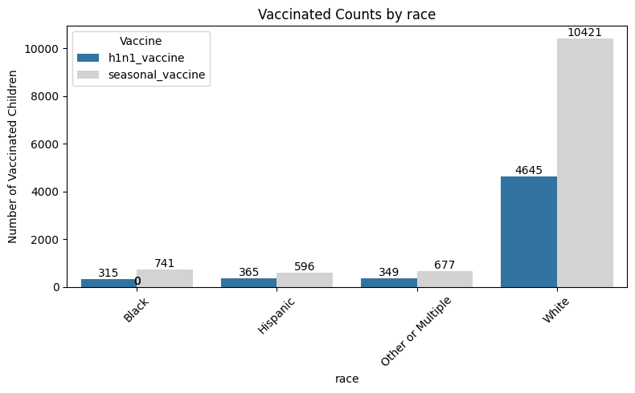
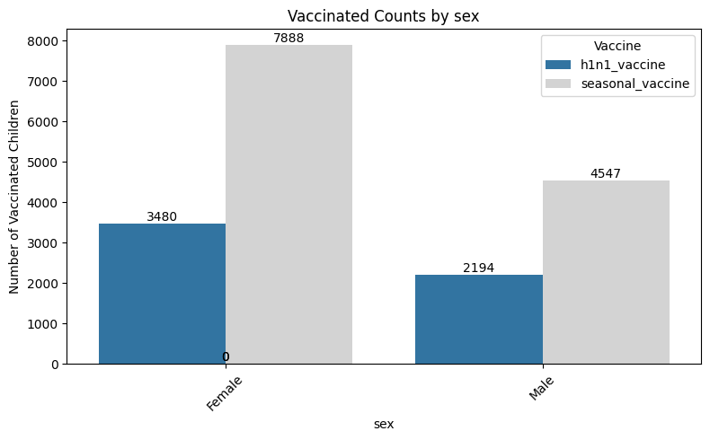
Key Findings (Demographics)
Income <= $75,000
Race : White
Education = College Graduates
Sex= Females

Slide 6
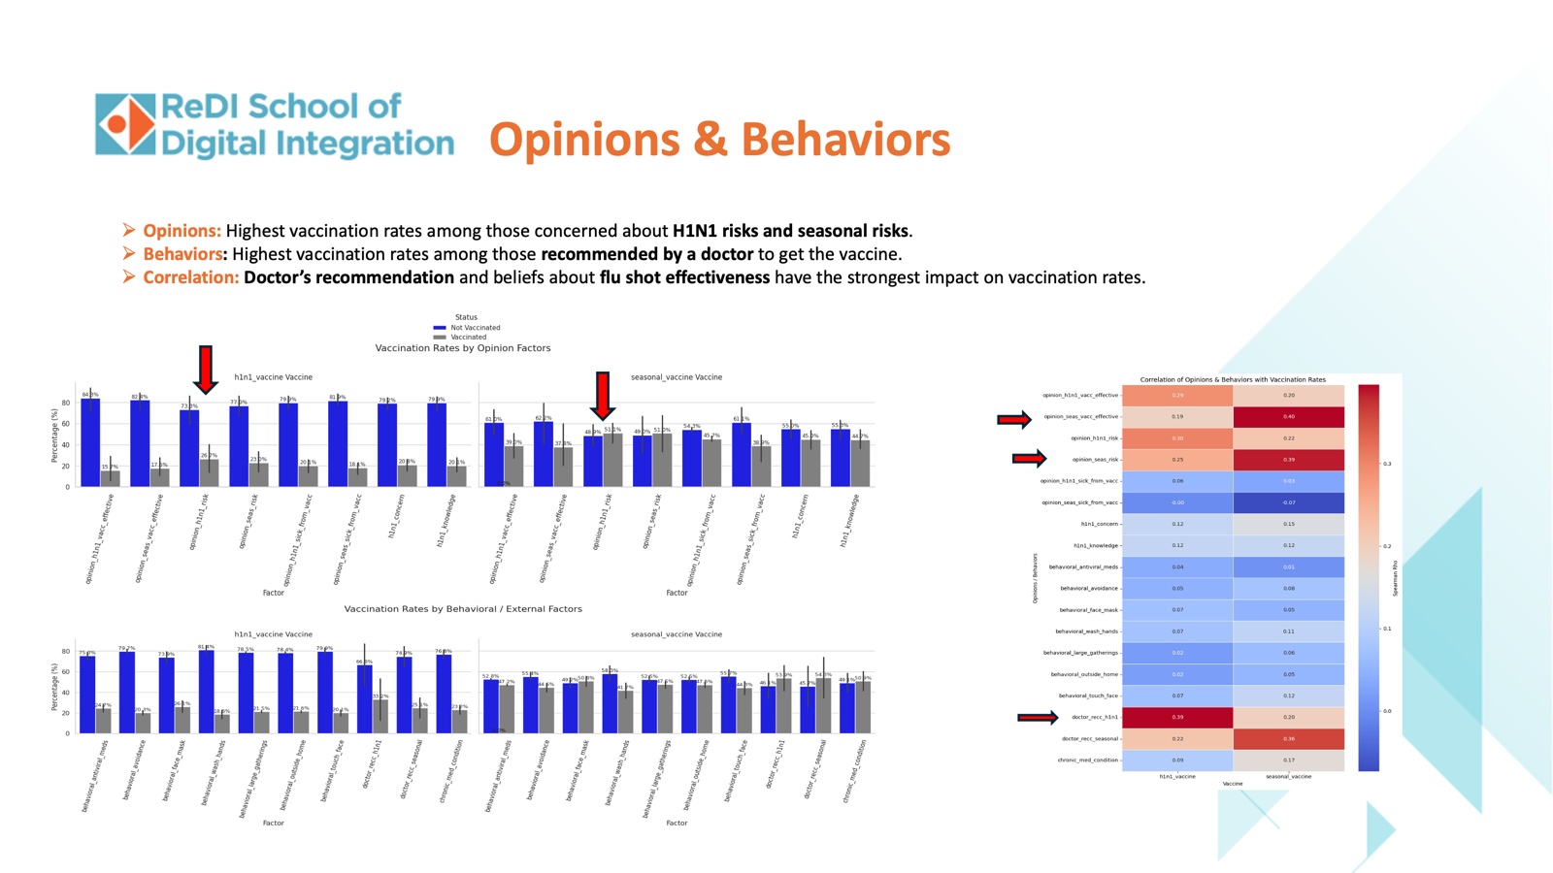
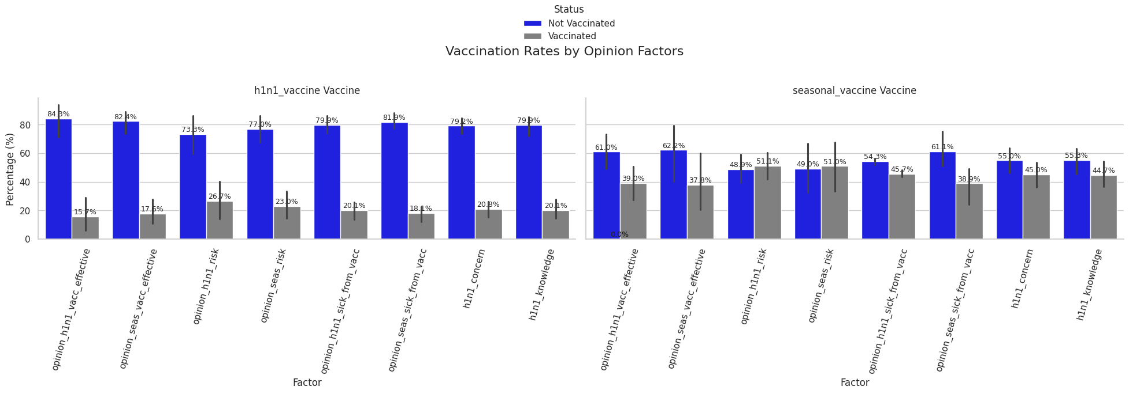
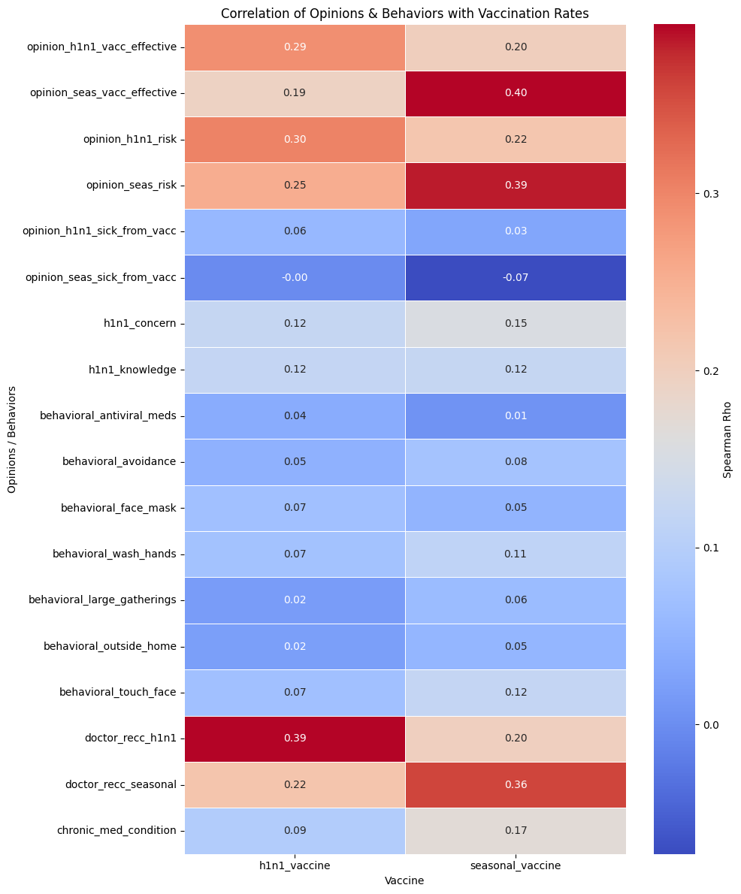
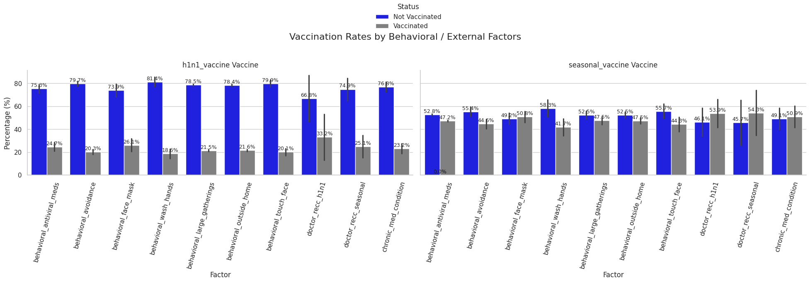
Opinions & Behaviours
Opinions: Highest vaccination rates among those concerned about H1N1 risks.
Behaviors: Highest vaccination rates among those recommended by a doctor to get the vaccine.
Correlation: Doctor’s recommendation and beliefs about flu shot effectiveness have the strongest impact on vaccination rates.

Slide 7
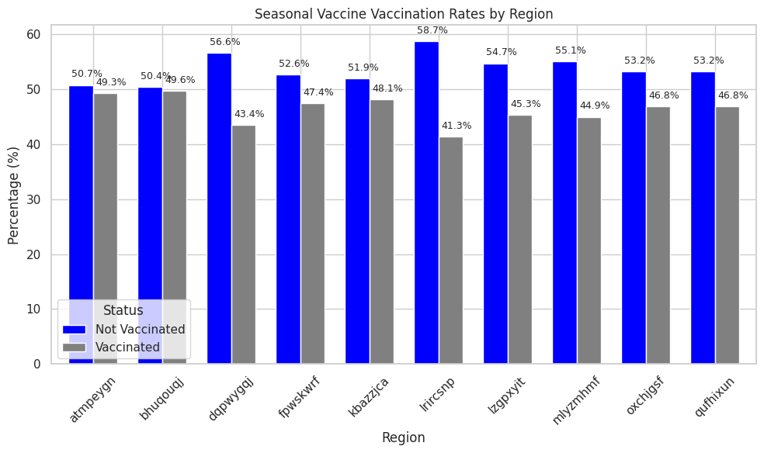
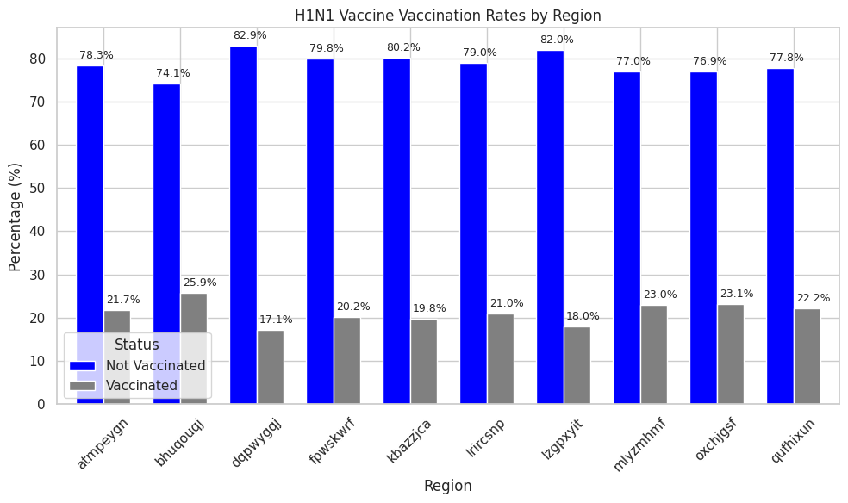
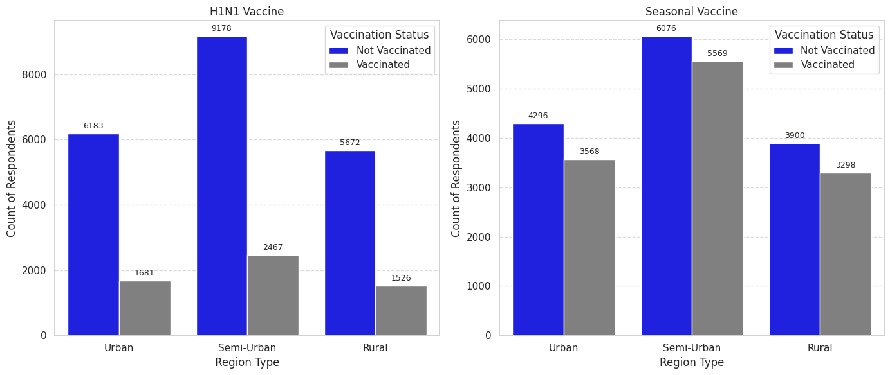
Key Findings (Location)
Region: “Bhuqouqj” recorded the highest vaccination rates.
Area type: Semi-urban residents received the most vaccines.

Slide 8
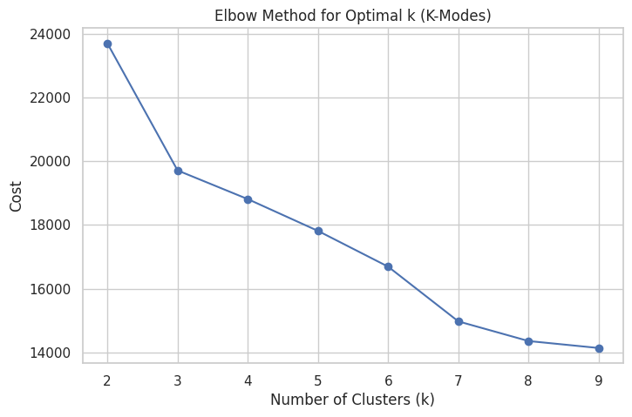
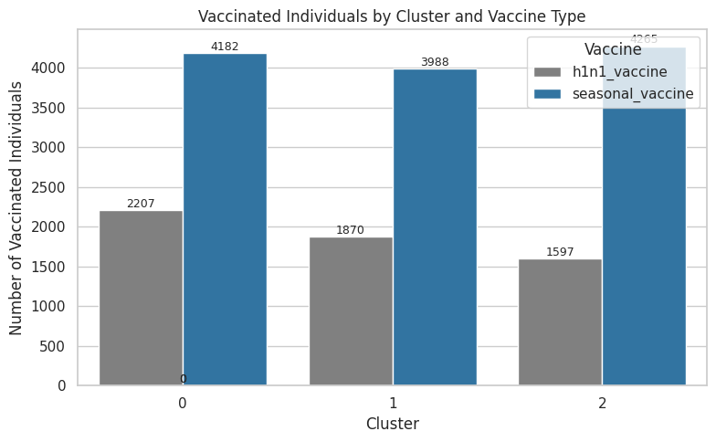
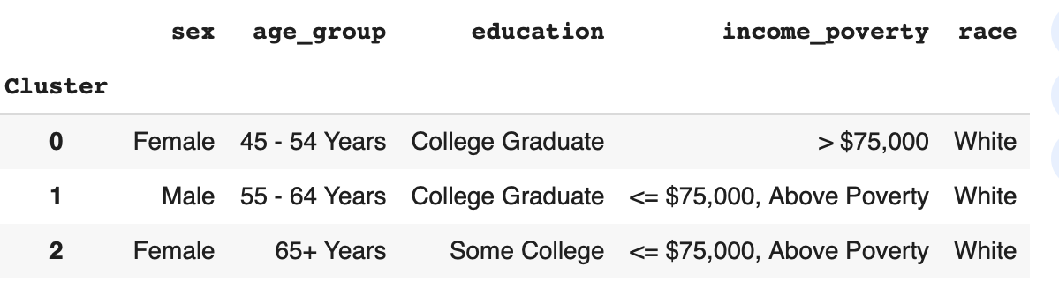
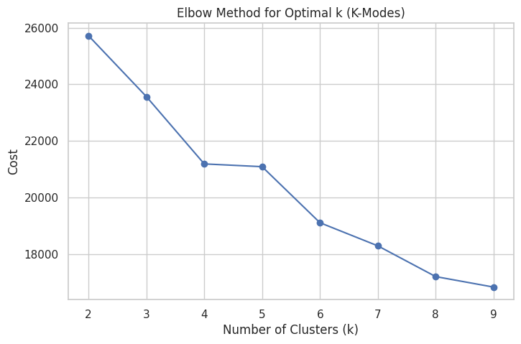
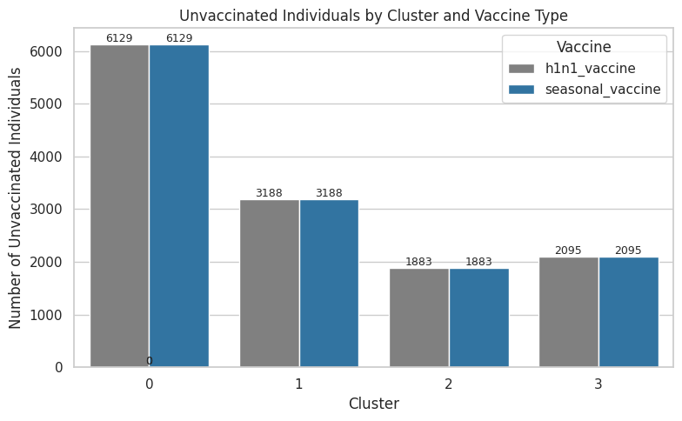
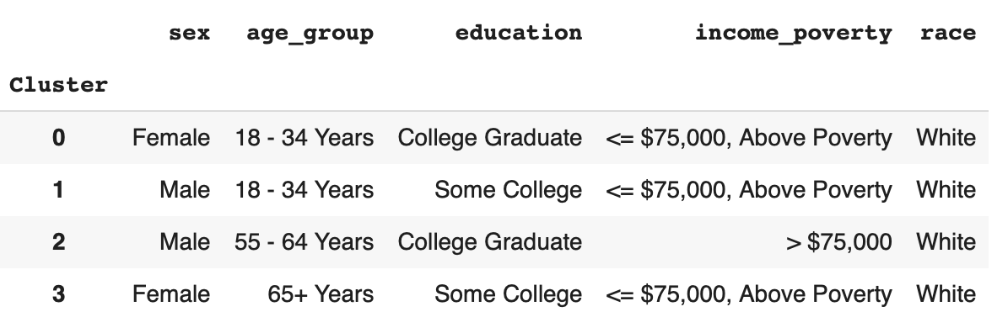
Cluster Insights
Vaccinated: 3 distinct groups identified — predominantly Females, College graduates, White, Income <=$75K, with varied age groups.
Unvaccinated: 4 distinct groups identified — Males & Females, College graduates & Some college, White, Income <=$75K, with varied age groups.
Notes:
Common variables- age group 5-9 and 10-14
Common region Northen
Common level of education primary

Slide 9
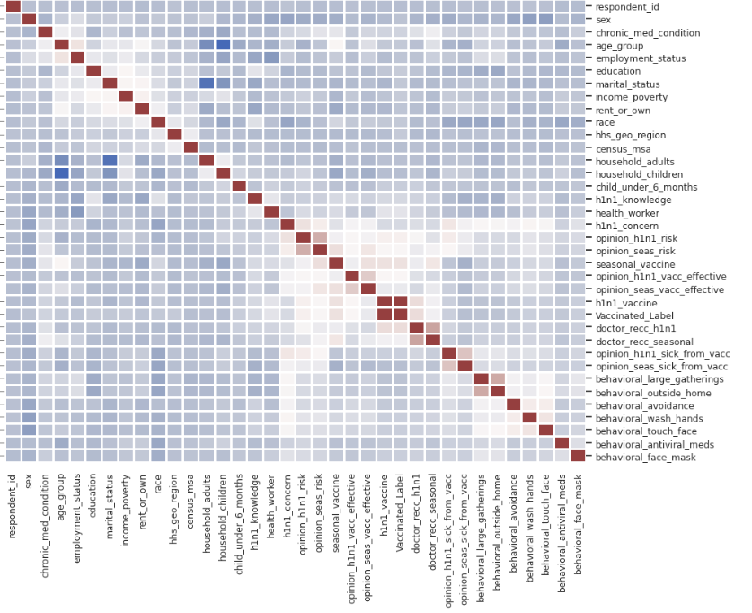
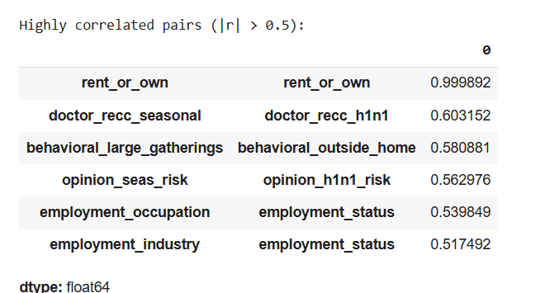
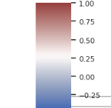
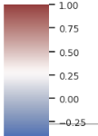
Feature Correlation Heatmap
Correlated columns: The columns that were highly correlated were
doctor recommendation of seasonal and h1n1 vaccine
Behavioral correction people who avoided large gatherings, also avoid been outside the home
People opinion of risk is similar in both seasonal and h1n1 vaccine
.
Correlated columns: doctor recommendation for seasonal and h1n1 vaccine
Behavioral correction people who avoided large gatherings, also avoid been outside the home
People opinion of risk is similar in both seasonal and h1n1 vaccine

Slide 10
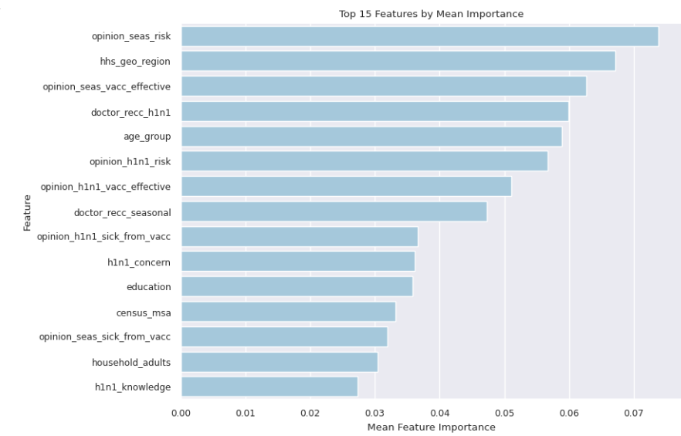
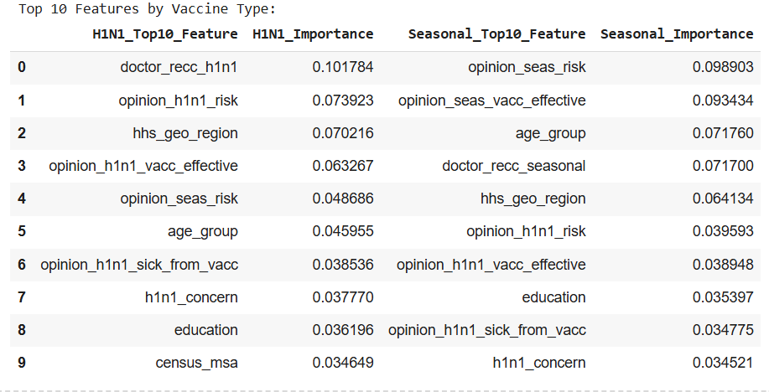
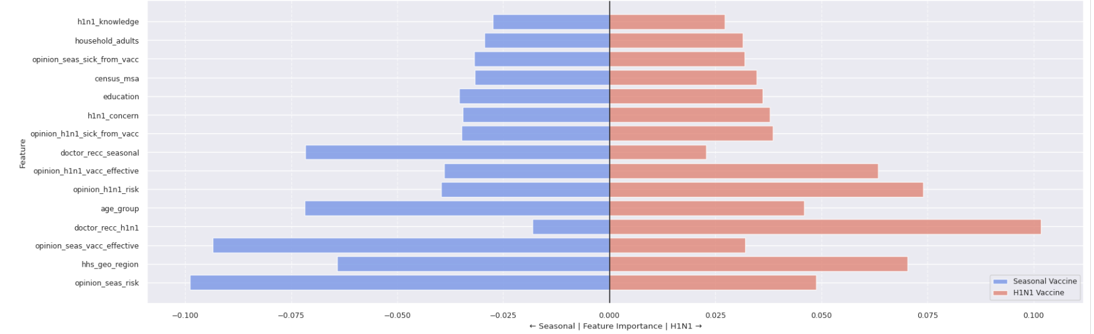
For the both vaccines the most important features are opinion_seasonal_risk, opinion_seas_vacc_effective, hhs_geo_region,doctor_recc_h1n1 and age group.
H1N1 dominant features: doctor_recc and opinion_h1n1_risk
Seasonal dominant features: opinion_sea_risk and opinion_seas_vacc_effective

Slide 11


Conclusions
Yes, demographics and behavior patterns influence the likelihood of accepting vaccination
Next step: Further analyze distinct groups to improve data balance and prediction accuracy

Slide 12

Thank You For Your Attention!!

